Slide 1

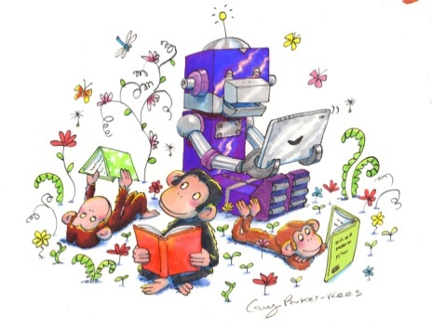

Enquiring minds – spring 2014
Sue Bastone
Conference Programme Director
Head of Learning Resources
LVS Ascot
Notes:
Our theme – we wanted a theme that would explore the pedagogy of our work as well as being a base for practical sessions.
We gave our keynote speakers a brief based on our theme.

Slide 2
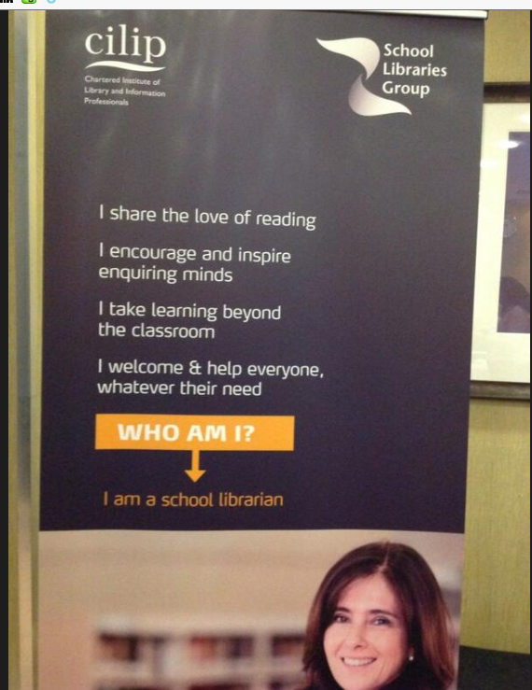
OUR BANNER!

Slide 3
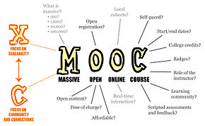
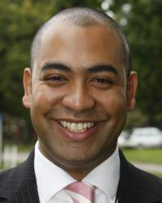
KEYNOTES – Nick Dennis
Nick Dennis – Academic
Deputy, Berkhamsted School
The Road to
Learning
Quoting E.P. Thompson,
British historian, writer, socialist and peace campaigner
“we could travel without maps for a while”
Thinking allowed – Mick Waters
Education needs to be beyond the exam hall to support learning
Humans have the need to read
Our brains are physically changed by reading …. Deep reading makes us more empathetic. If reading were to decline it would change the very nature of our species Gail Rebuck in the Guardian Dec 2011
“I’ve been to the crossroads and I’ve seen the devil there”
Sven Birkerts, the Gutenberg Elegies 1996
Notes:
Nick Dennis - Nick Dennis, Academic Deputy Head at Berkhamsted school, SLG conference April 2014 – keynote speech – The Road to Learning – not one road, but many paths i.e. Instead of sticking to our “map” we need to find creative and innovative ways to make a difference to literacy.
Sven Birkerts wrote a passionate defence of the printed book - Birkerts argues with passion and dismay that modern electronic communication and information technologies have brought our culture to "what promises to be a total metamorphosis.... Herded by electronic impulses and fibre optics into a global mass, what we most disastrously risk losing, Birkerts fears, is what books provided: the opportunity to read, pause, reflect, reread, memorize, reflect some more. We risk the part of our minds and hearts capable of depth, meditation, inner expansion. Progressively, Birkerts implies and constantly reiterates, each embrace of newer, faster technology becomes another step away from the fathomless, individualized self, the profound inner space of tranquillity where we find aesthetic and spiritual centeredness.
ND talked about different ways of learning – MOOCs, HPQ and ways of getting involved with pupils’ learning - cited Mick Waters as example of current thinking
“Thinking Allowed on Schools” - Need to take a more expansive view than Ofsted criteria – more historically rich, how many students represent school at sport, spend a night out camping, take part in drama productions etc. These things are not measured. Education needs to be beyond the exam hall to support learning – many schools doing HPQ in Year 9. ND also mentioned Project based learning

Slide 4
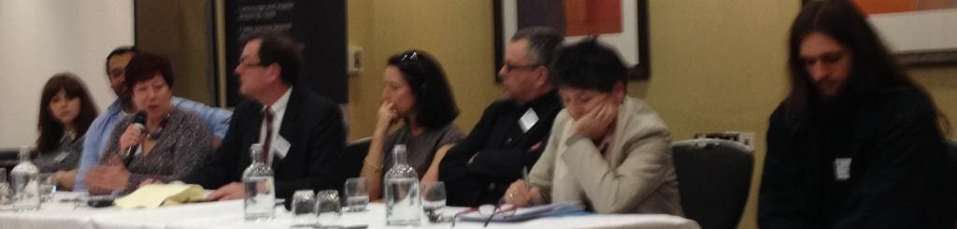
KEYNOTE – QUESTION TIME PANEL
Headteacher Geoff Barton says that we should model reading aloud, even at secondary level, what do the panel think ?
What does the panel think about the recent decision to ban prisoners from being given books?
What do the panel feel are the most effective ways of ensuring that children not only learn to decode print but develop a lifelong love of reading for pleasure?
Why did librarians only come 43rd on the happiness index as reported by the BBC
Kindle or real paper ?
Notes:
Panel members
Abbie from Heanor Gate science college – amazing student!
Nick Dennis, Barbara Band, John Hess, Seni Glaister, Alan Gibbons, Claire Fox (IoI), Angus (student)

Slide 5
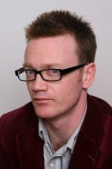
KEYNOTES – FRANCIS GILBERT
Francis Gilbert – Teacher,
Researcher, Writer
What is Education for
and how do school
libraries and librarians
contribute ?
What is Education for?
Ideals: Eudemonia (human flourishing), Independent learners, creators, motivated, happy, imaginative, moral.
Paulo Freire – the Pedagogy of the Oppressed –
starting point is people’s lives – education has to be relevant to its context
The Freirean library
The lived “experiences” of the members of the library are celebrated and show-cased:
Work is displayed
Books are published (self-publishing)
Students/teachers are celebrated
Links are made between lived experience and text
Cartoon bubbles for students talking about books they like…
Cards where students/teachers write about favourite books
The library is a magical, mystical space; a rare space for people to fall in love with books.
The “social control” library
A clear hierarchy of books which mirrors the social class system:
Simple texts for the “less able”, for the poor, socially deprived, or a policy of exclusion: you’re not welcome here…
More advanced texts for the elite, the rich, the advantaged middle-classes
A strong emphasis on social control: silence, the librarian as the custodian of the social/literary hierarchy
Notes:
Francis was a fascinating speaker. He began with the question What is Education for and outlined the ideals. He talked about education as social control, the school system preserved the class system from Victorian times through to grammar and secondary education. Now of course it still does in many ways.
He talked about the “social control library” and how important it is to avoid it.
Paulo Freire – start with people’s lives to find ways of engaging them. Freirean questions: What are your first reading experiences?
What are your childhood memories of libraries?
What are your positive experiences of books as a child?
The shift from social control to emancipation
The “Freirean” approach which starts with the “learner” and acts in a profound, political way to nurture and enrich students’ lives
The “post-modern” condition; adapting to this; thinking creatively; reclaiming the name of “library”; establishing the primacy of the book.
The library is a magical, mystical space; a rare space for people to fall in love with books.

Slide 6
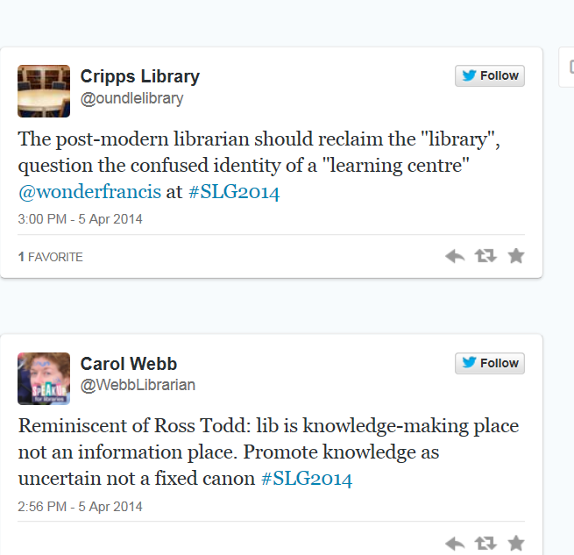
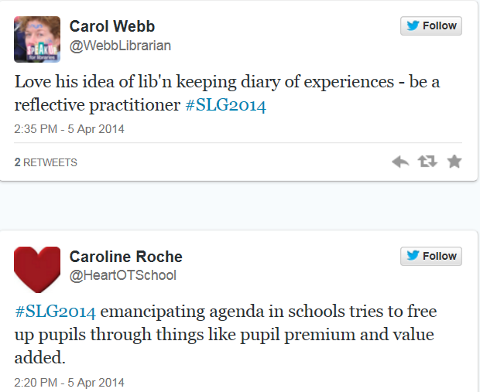
Delegates’ thoughts
You can see a selection of Tweets from the Conference in a Storify:
https://storify.com/Cilipslg/slg-2014-conference-enquiring-minds

Slide 7
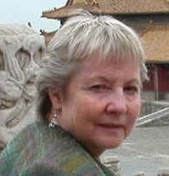
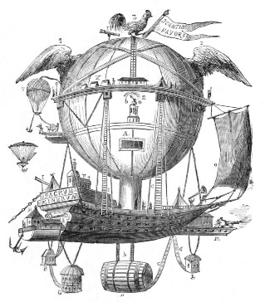

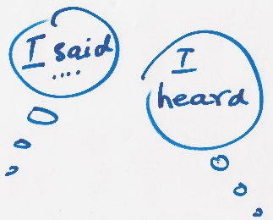
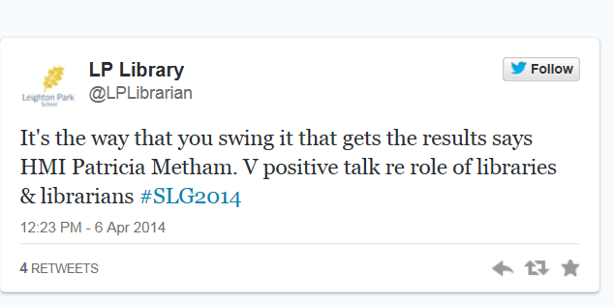

KEYNOTES – PATRICIA METHAM, HMI
Patricia Metham, HMI
National Lead for
English, Ofsted
A curriculum for Enquiring Minds
‘To boldly go…’
Exploration
Enquiry
Imagination
A sense of purpose
Skills
Reading – is it fun in our schools? Is it challenging ? All children should:
read easily, fluently and with good understanding, develop the habit of reading widely and often for pleasure and information.
If you can speak and listen well, you can:
Enquire, explore, explain, engage, enhance & entertain
‘I like new words. They make my world bigger.’
The NC calls for all pupils to read:
good fiction & non-fiction, poetry & prose from ‘our literary heritage’
film & digital texts
across subjects
world literature written in English.
How well are we covering these?
Librarians should be on every curriculum committee!
Notes:
Tricia talked about the importance of literacy, quoting NLT 2012 – one in every six adults struggles with literacy.
In 2011 employers had concerns over employees’ ability to:
Read and understand basic texts, understand and reply clearly to spoken instructions, construct properly spelt, grammatically correct writing.
How important it is that everything in a school is spelt correctly. Spelling and punctuation is power not a chore!
The curriculum - Is the experience purposeful? Is the learning sustained?
Must reflect the literary and cultural heritage of ALL our students
Importance of speaking and listening
Read from Michelle Paver – explain the connection!
Whole text experience essential but a well-chosen extract can encourage pupils to: explore how language is used, use clues to suggest further possibilities, respond imaginatively, develop critical skills.
Encouraged us to read aloud, use picture books – visual literacy very important and accessible. Stock wide range of texts in different formats.
Encourage new vocabulary.
Inspire a thirst for discovery, a love of language and story.
Said librarians should be on every curriculum committee!
Impossible for school to be judged outstanding unless pupils read widely for pleasure.
Said if she goes into a school without a library she wants to put them in special measures – we clapped!

Slide 8
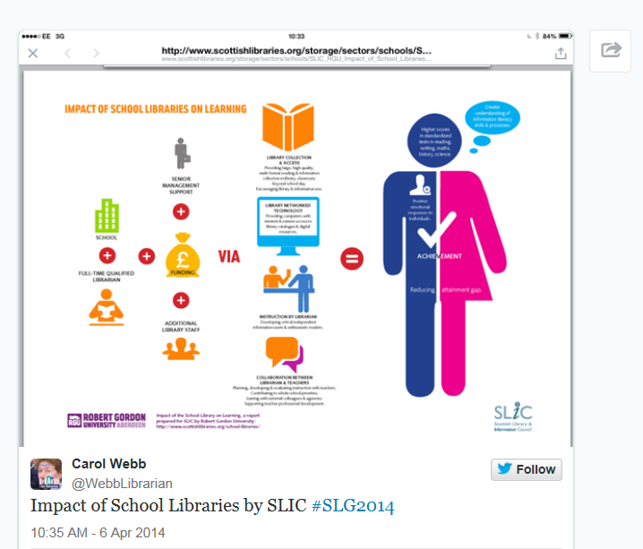
Recent research
Notes:
Impact of School Libraries on Learning – Robert Gordon University, October 2013 – very positive research, worth reading.

Slide 9
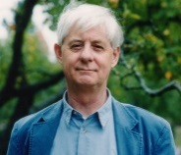
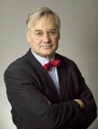

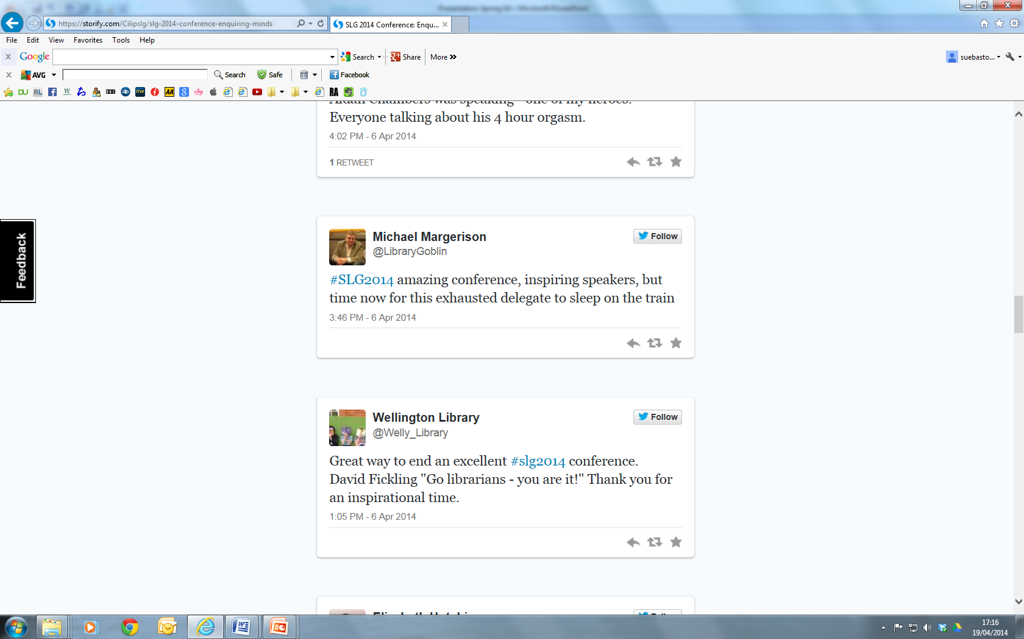
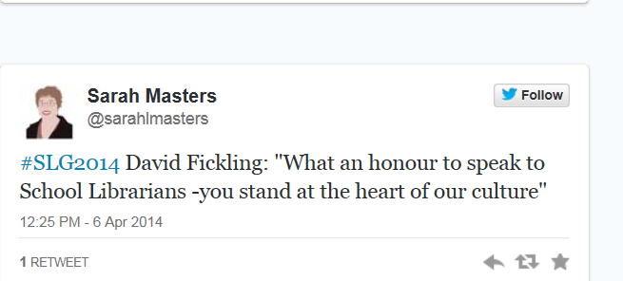
KEYNOTES –
AIDAN CHAMBERS AND DAVID FICKLING
Two passionate speakers
Aidan Chambers, author
Why Read ?
David Fickling,
David Fickling Books: Publishing for Enquiring Minds
Notes:
Aidan Chambers - Thought-provoking – why read – so important for kids – think – learning need to be inspired – set context for reading – roles we have as librarians – find the route – made us think more broadly. Key part of librarian’s job is KNOWING THE BOOKS!
David Fickling – talked passionately about publishing – his mission is to create stories and excitement for all children. Some of the brightest people on the planet are dyslexic. Has launched a weekly story comic, The Phoenix as he loved comics as a boy. Gave us sneak preview of Philip Pullman’s new book – from the draft manuscript! Artificial barrier between reading and maths and science – he is the man behind the Horrible Histories.
Do more reading aloud

Slide 10
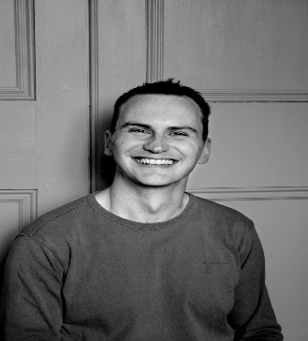
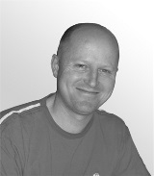
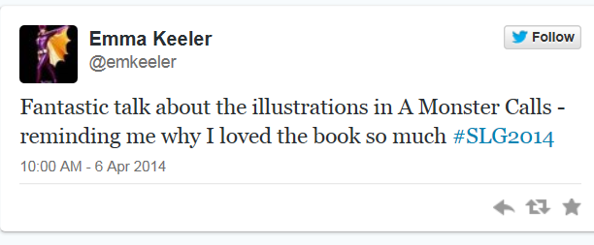
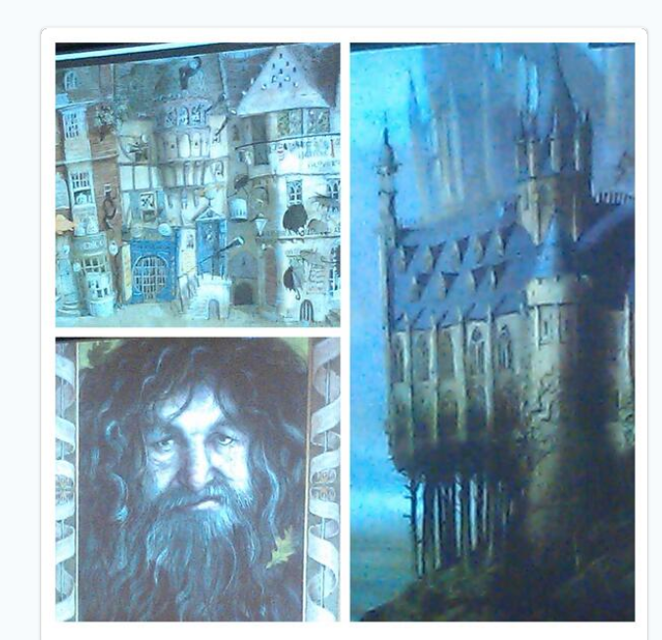
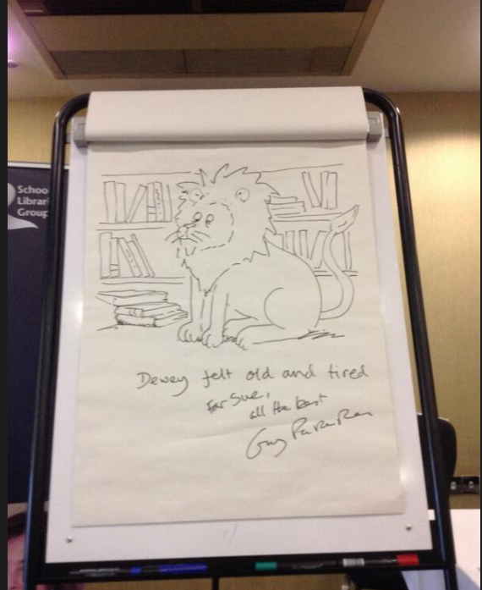
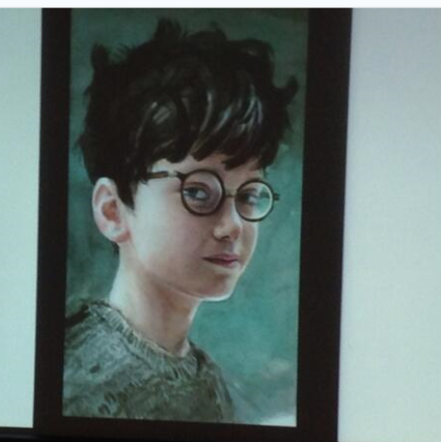
Keynotes – stories through pictures
Jim Kay
Guy Parker-Rees
Notes:
Jim Kay – illustration more stressful than you’d think!
shared amazing concept drawings for new Harry Potter edition
Guy Parker-Rees – designed conference logo.
25th anniversary of Giraffes can’t dance. Drew a picture for the conference which I won!

Slide 11
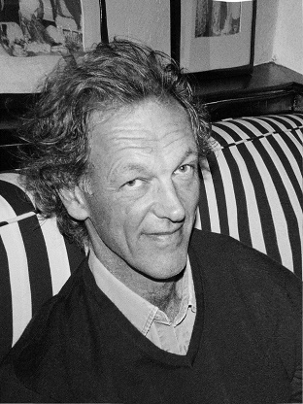
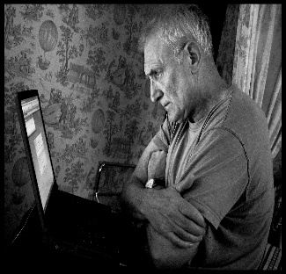
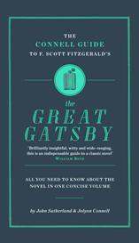
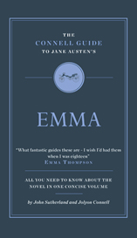

KEYNOTES – connell guides
Jon Connell , Founder of
The Week
John Sutherland
Northcliffe Professor Emeritus, UCL
Notes:
Connell Guides new guides to English set texts. “like putting lots of academics in your pocket”

Slide 12
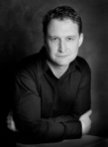
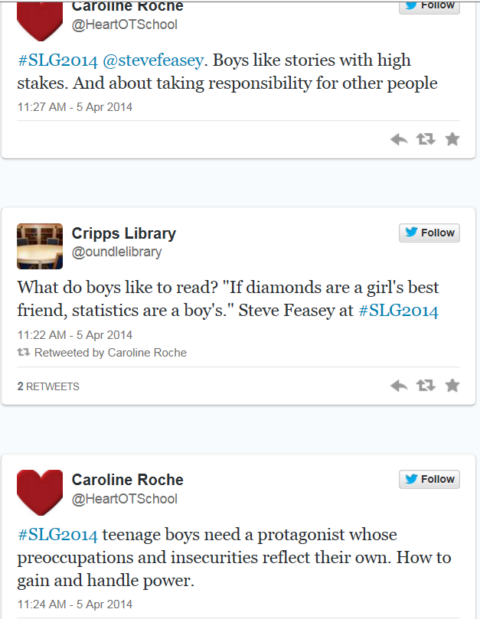
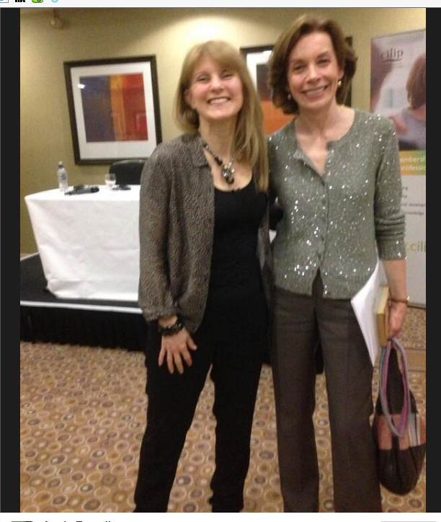
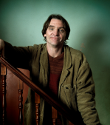
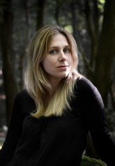
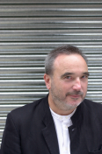
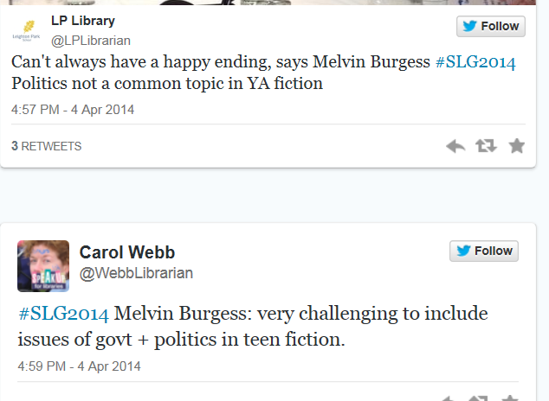
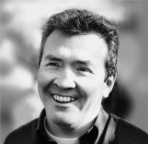
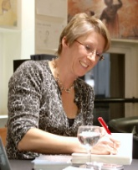
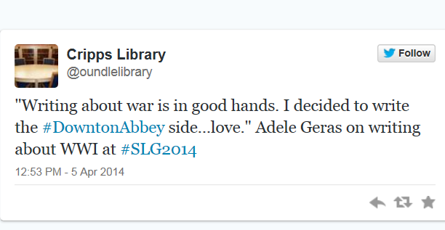
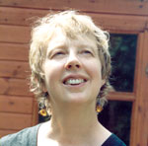
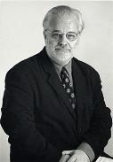
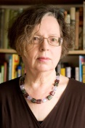
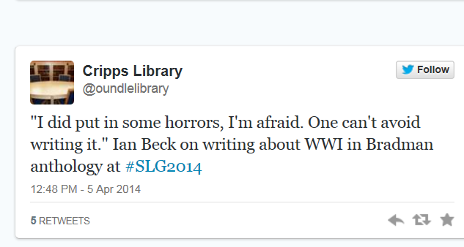
AUTHOR ROUNDUP
World War I Author Panel
Notes:
Sally Green & Michelle Paver
Barry Cunningham with Melvyn Burgess & Lucy Christopher - Explored themes of their novels and what young people are looking for. Controversial subjects – teenagers want to read about these topics – need a range.
Steve Feasey - differences girls and boys, what do boys like ? what does every reader like ? how do we do that ? same message as AC but in a different way – very funny – sparked good conversations afterwards
WW1 panel – chaired by Tony Bradman with Ian Beck, Leslie Wilson & Adele Geras Excellent discussion with each author talking about the settings and content of their stories in the new anthology but also the themes which link them.
Ask delegates at meeting to contribute if they were at conference.

Slide 13
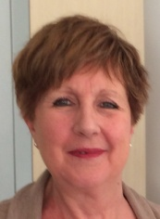
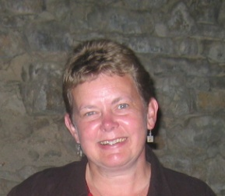
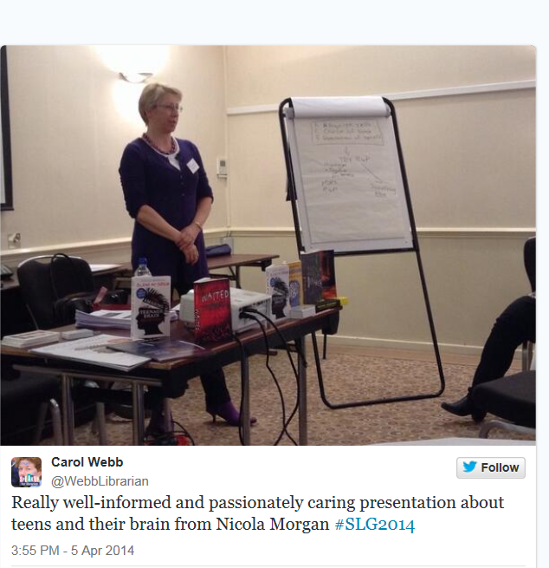
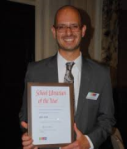
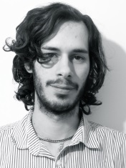
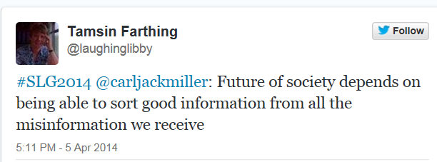
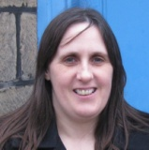
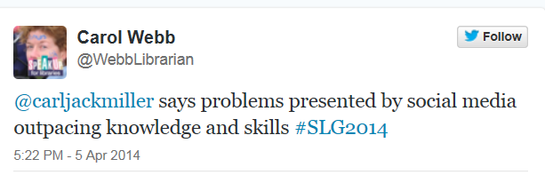
SEMINARS - LITERACY
JCS – Disseminating and exploiting your digital library
Dr. Val Hindmarsh - Reading Recovery/Grow@KS3
Nicola Morgan - Blame my Brain
Sally McIntosh & John Iona – Supporting the Extended Project
Truth, Lies and the Internet
Notes:
A range of seminars dealing with all aspects of literacy. Those available on website:
Reading Recovery – a new literacy intervention for Year 7 struggling pupils
Sally & John – EPQ
Truth, Lies & Internet – Demos Report 2011 can be downloaded free from DEMOS website
Nicola Morgan – lots of information on her website

Slide 14
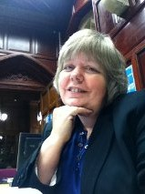






SEMINARS – NEW TECHNOLOGIES
Sarah Pavey:
Two Libraries are better than one – a Tale of Public Library Collaboration
New Ways to Engage (for Helen Cleaves)
Fakebook
Aurasma
Skype
Julian Wood:
Using IT to encourage children’s reading and writing
Notes:
Sarah delivered two seminars for us, one for Helen Cleaves.
Collaboration with Surrey Public Libraries provides a wealth of resources online for their students – for FREE!
Access to all the online resources, plus audio books, e-books. Worth investigating. I’ve tried Bracknell Forest but more difficult.
Helen Cleaves’ presentation on new tools to engage students with reading
Lots of good ideas – look at the presentation
Most presentations on CILIP website - http://www.cilip.org.uk/school-libraries-group/events-and-presentations/conference-2014-enquiring-minds?destination=node/3744
(not Julian Wood yet)

Slide 15



SEMINARS - CPD
Andy Cope – The Art of Being Brilliant
Warwickshire SLS – Assessing the health of your library and
sharing good practice
Margaret Chapman - CPD & You – getting the most out of everything you do
Librarians’ Surgery
Notes:
Andy Cope – are you a 2% er ? Wake up every morning “I’m glad I haven’t got toothache!”
Warwickshire SLS –setting up an eplatform for their schools
Margaret Chapman – trainer & consultant, CILIP mentor

Slide 16



SEMINARS – IMAGINATIVE & CREATIVE THINKING
Carl Cross – Comics and Graphic Novels in Schools
World War One Author Panel
Professor Joan Swann - Enriching Reading for Pleasure –
The Impact of Shadowing
C and T – Creating Independent and Imaginative Thinkers
Notes:
Carl Cross – manga not as popular as 6 years ago – caused much discussion amongst delegates – presentation on website
WW1 author panel – already mentioned
Joan Swann – Impact of Shadowing - With Professor Teresa Cremin, also at the Open University, she recently carried out an evaluation of the CILIP Carnegie and Kate Greenaway Shadowing Scheme, whereby young people shadow the judging of two major children’s book awards. An important focus of the evaluation was on how Shadowing Groups are organized, the role of librarians and other group leaders, and how children are supported in their collaborative discussion of the short-listed texts.
C and T – nothing yet

Slide 17


AND OTHER THINGS ...
SLG AGM
CILIP Guidelines for Secondary School Libraries, 3rd edition,
just published
“What makes a good school library” leaflet for Parents & Governors, download from CILIP website
Pupil Library Assistant of the Year Award launched by Barbara Band, President of CILIP
World War One Pack
Notes:
SLG Guidelines, updated 3rd edition available now from Facet Publications
To take:
Parent/Governor leaflets
PLAYA leaflets
WW1 Pack - CILIP's School Libraries Group is pleased to announce the publication of "World War 1: Book Group Discussions and Activities". This loose-leaf pack features fourteen works of fiction, poetry and non-fiction and a competition which calls for a creative response to one of these works.
It is primarily intended as a source of ideas for librarians working with reading groups but will also be useful in classroom situations. However, we hope that our members will also use it as an advocacy tool to introduce history teachers to our work and foster collaboration between them and the librarian.
Available free as a download on SLG site from end of April or hard copy £5 plus p&p

Slide 18






What they thought

Slide 19
Slg chair – sue shaper
All have our own interests and concerns
We make links and create new knowledge
Two themes emerged for me –
What are we for ?
Reading Aloud
IMPACT FOR YOU AND YOUR SCHOOL
Great opportunities – discussion, networking, new knowledge
Knowledge, practical ideas, new ways of working
Professional validation
Inspiration
Are you a CILIP member ?
Notes:
We all arrived at the beginning of the weekend with our own interests and concerns and as we have attended the range of sessions each person picks out thoughts relevant to themselves, considers them, makes links and creates new knowledge. Therefore, it is impossible for me to sum up a conference for other people and all I can do is tell you about the two themes that have emerged for me and that I will take away and work on.
Firstly, we need to decide what we are for. Clare Fox said that we are trying too hard to be everything to everyone. Francis Gilbert said that we should ask continually what the library is for and who it is for. Andy Cope said that to be happy we need to start with why we are doing something. Patricia asked why the library matters and what is the value of whole texts - not that we don't know but that it is good to re-examine and articulate.
The other theme for me was talking about books and reading aloud. One question time question was about reading aloud. We need to hear how the sentence sounds to get its impact. The Carnegie shadowing session learned about the huge value of discussion. Aidan Chambers talked about questioning. David F. read aloud to us from the new Philip Pullman novel, suggested that we arrange readings in school and highlighted the pleasure of being read to. Finally, Patricia responded from the audience to tell David that in her experience the quality of reading aloud can be poor.

